Slide 1
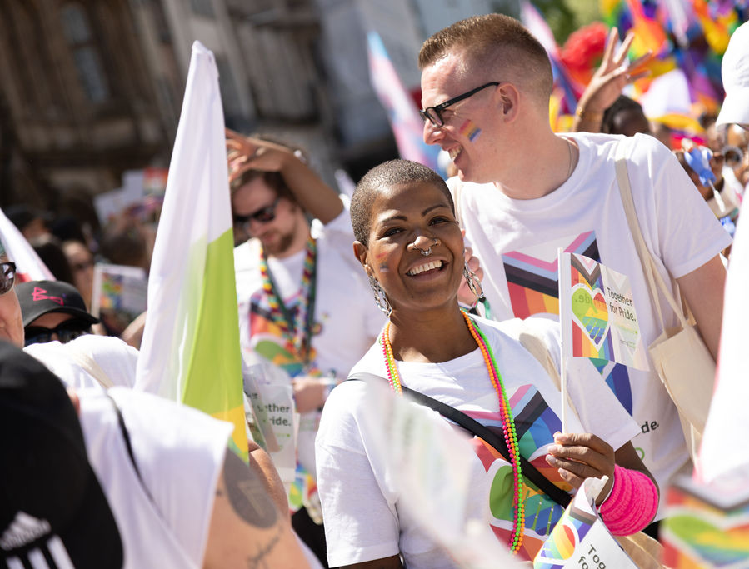
Allyship

Slide 2
What is Allyship?
“The actions & behaviours to support, amplify & advocate for others.”
“The active support for the rights of a minority or marginalized group – without being a member of it.”
The support of those who don’t belong to the same social identity groups as you.
You can be an ally for disabled people, racial and ethnic groups, religious, LGBTQ+ identities, women etc.
Being an ally means supporting and actively working to protect and advance the rights and wellbeing of those less privileged.

Slide 3
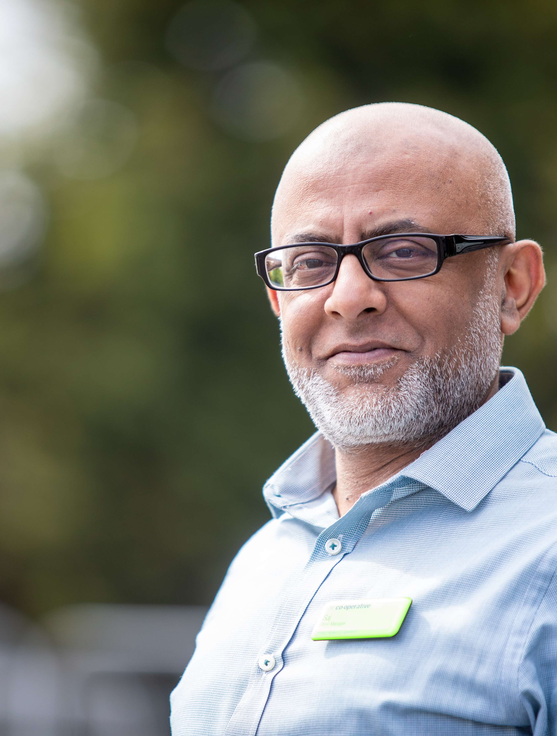
Why is Allyship important?
Being an ally means better understanding of the challenges faced by others.
It means actively trying to make changes to create greater equity and fairness – levelling the playing field.
Because an ally may have more privilege, they can be powerful voices alongside those from less privileged groups.

Slide 4
How to be an Ally in the workplace
Get to know people and pay close attention to their words and ideas.
Mirror the language that someone uses to describe their identity.
Acknowledge what’s important to them.
Work hard to encourage participation from everyone in your team.
Notice when someone isn’t participating and support them.
Recognise someone's achievements.
Amplify their voice.
Invite someone to speak and share their expertise.
Provide regular, quality positive and constructive feedback.

Slide 5
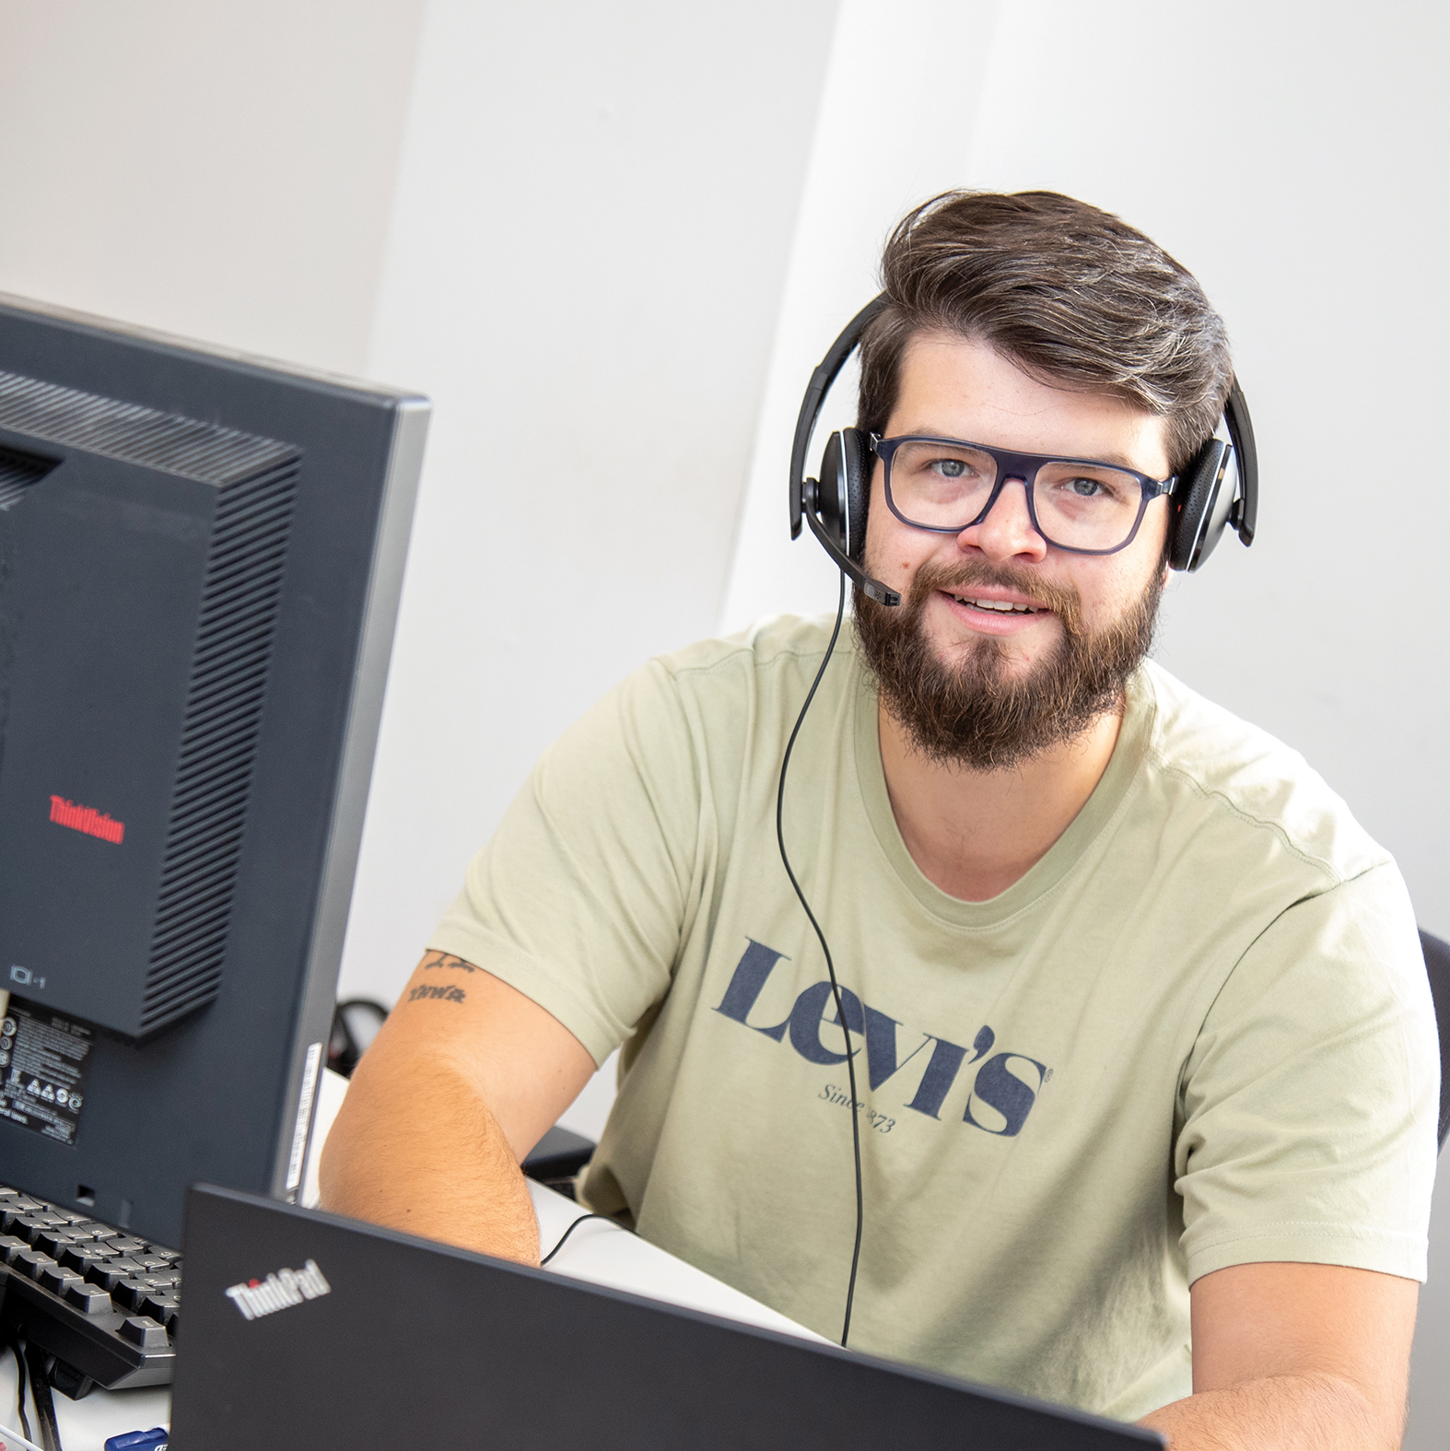
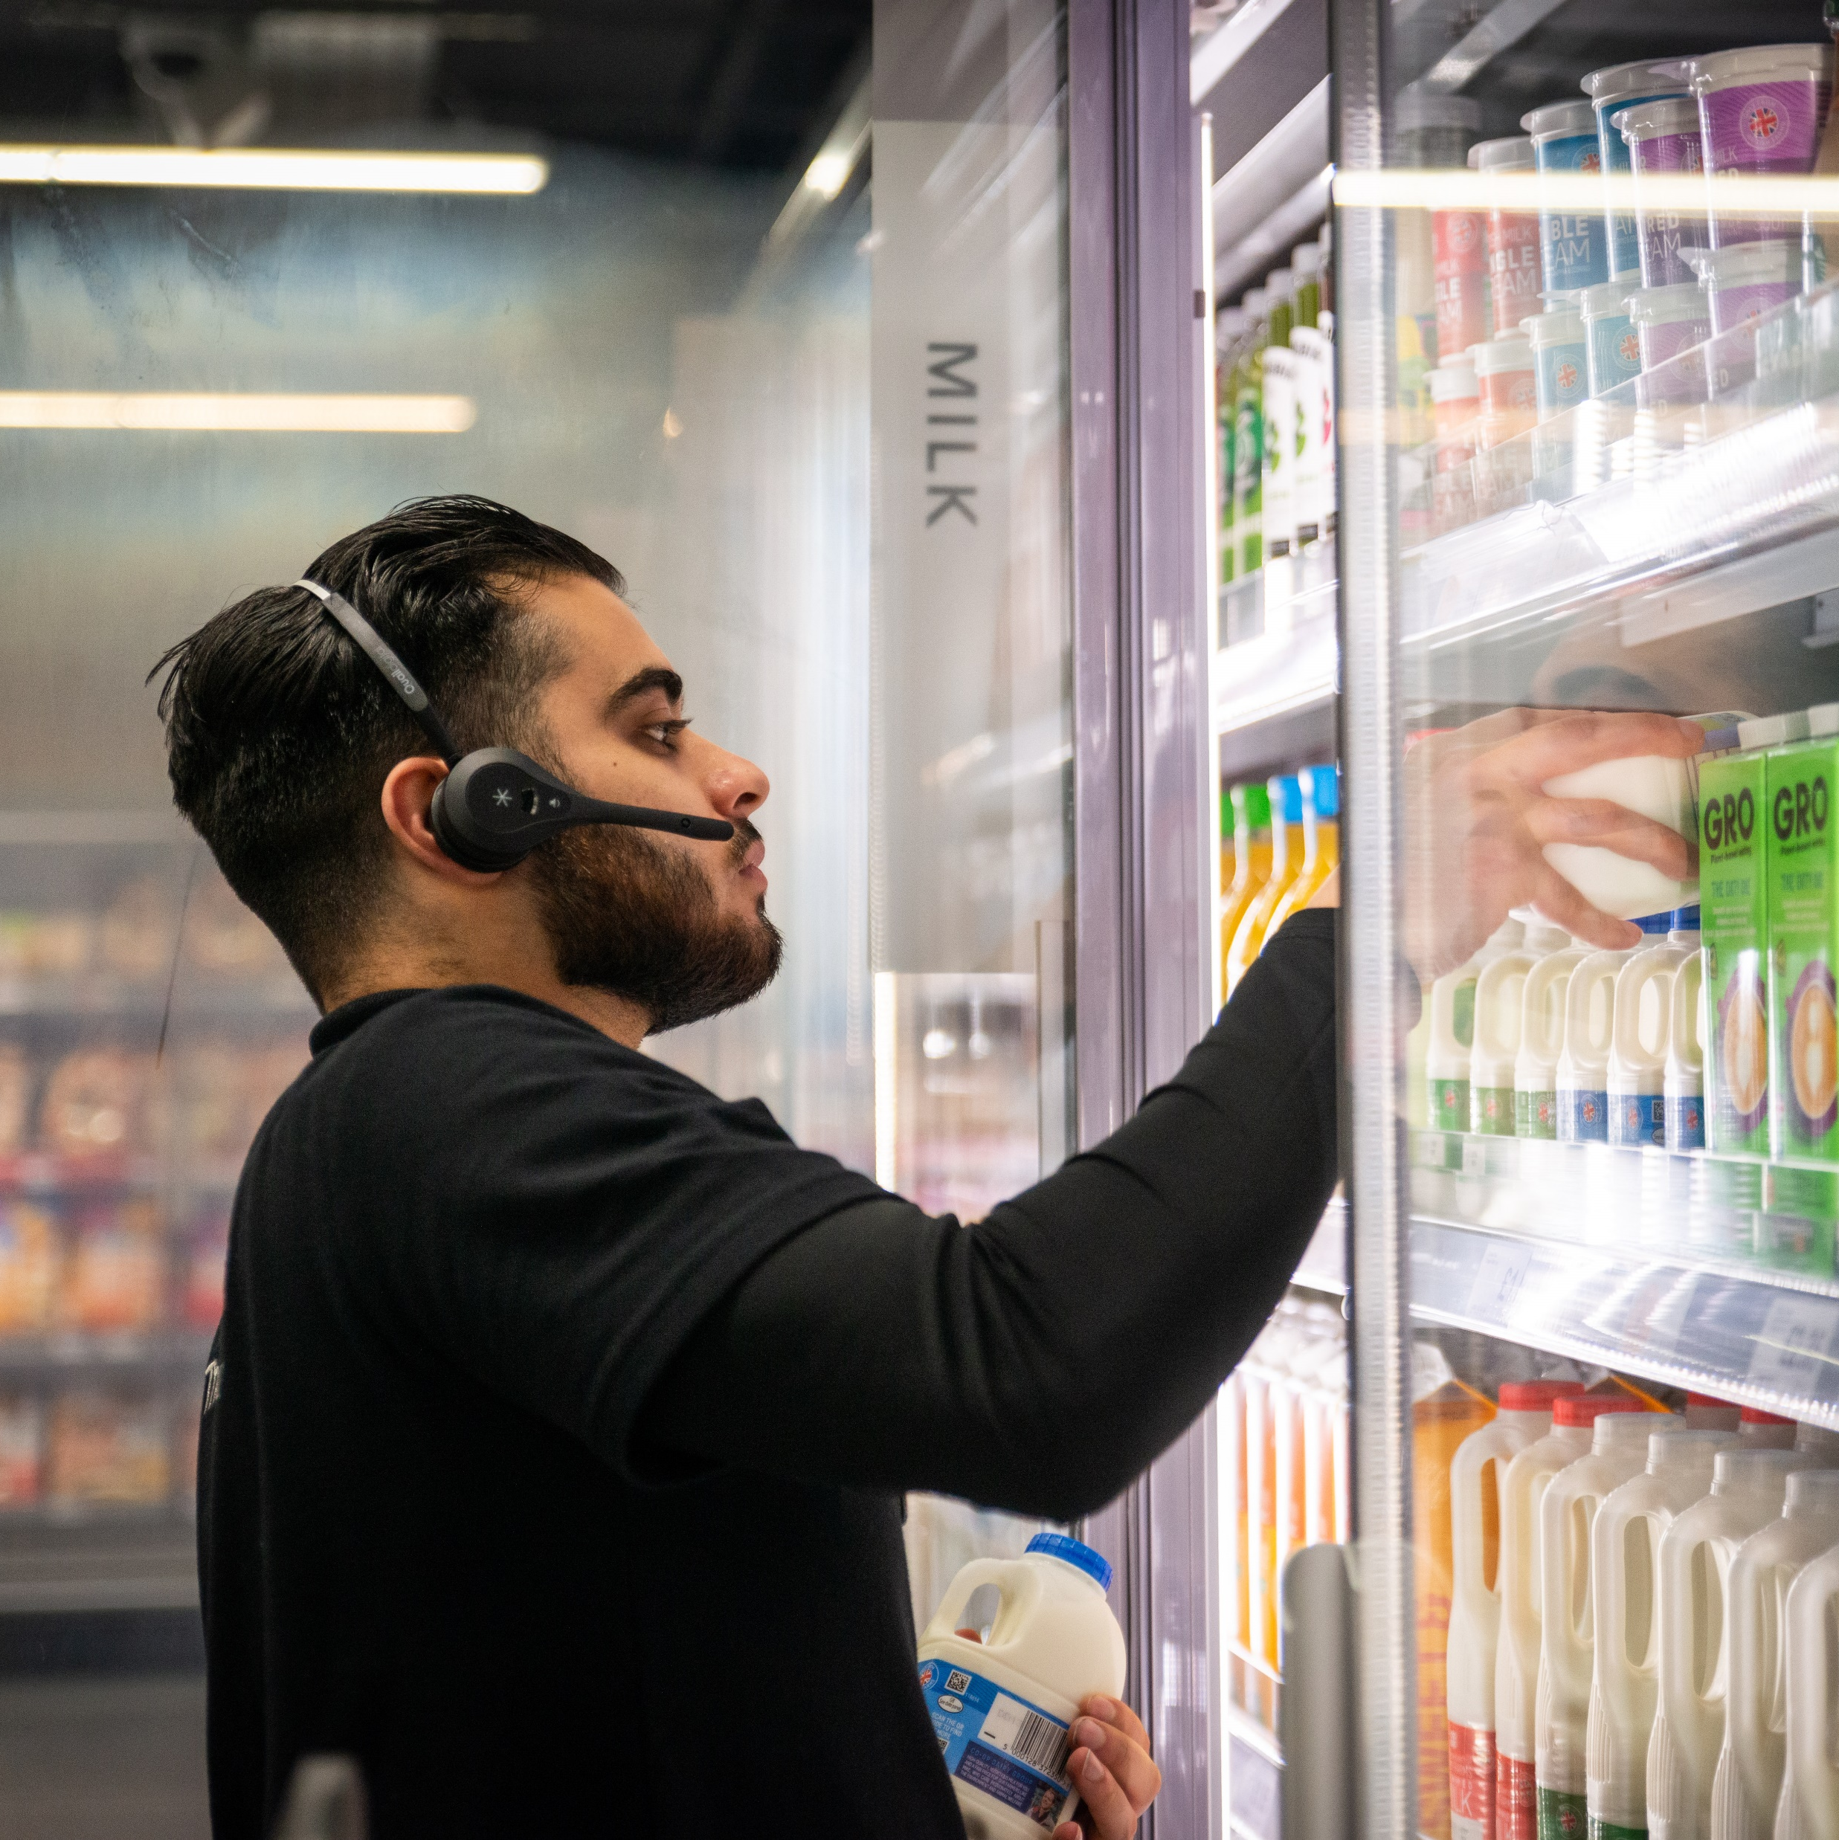
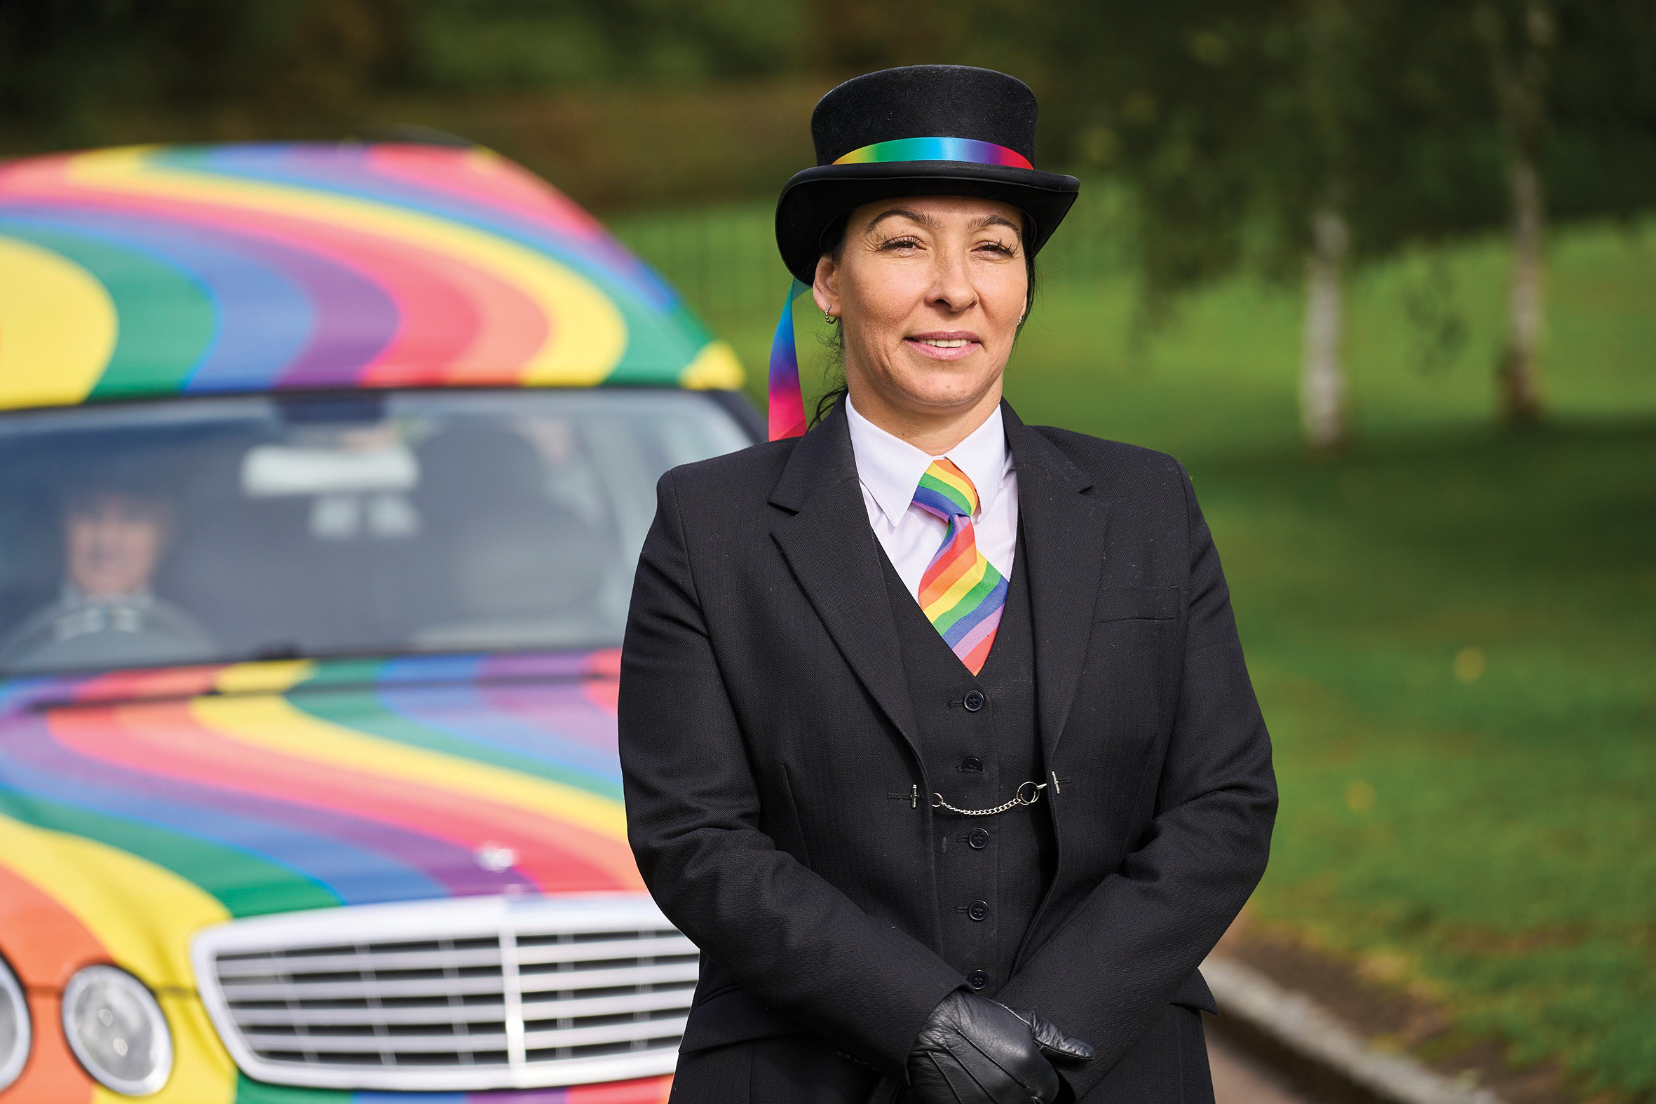
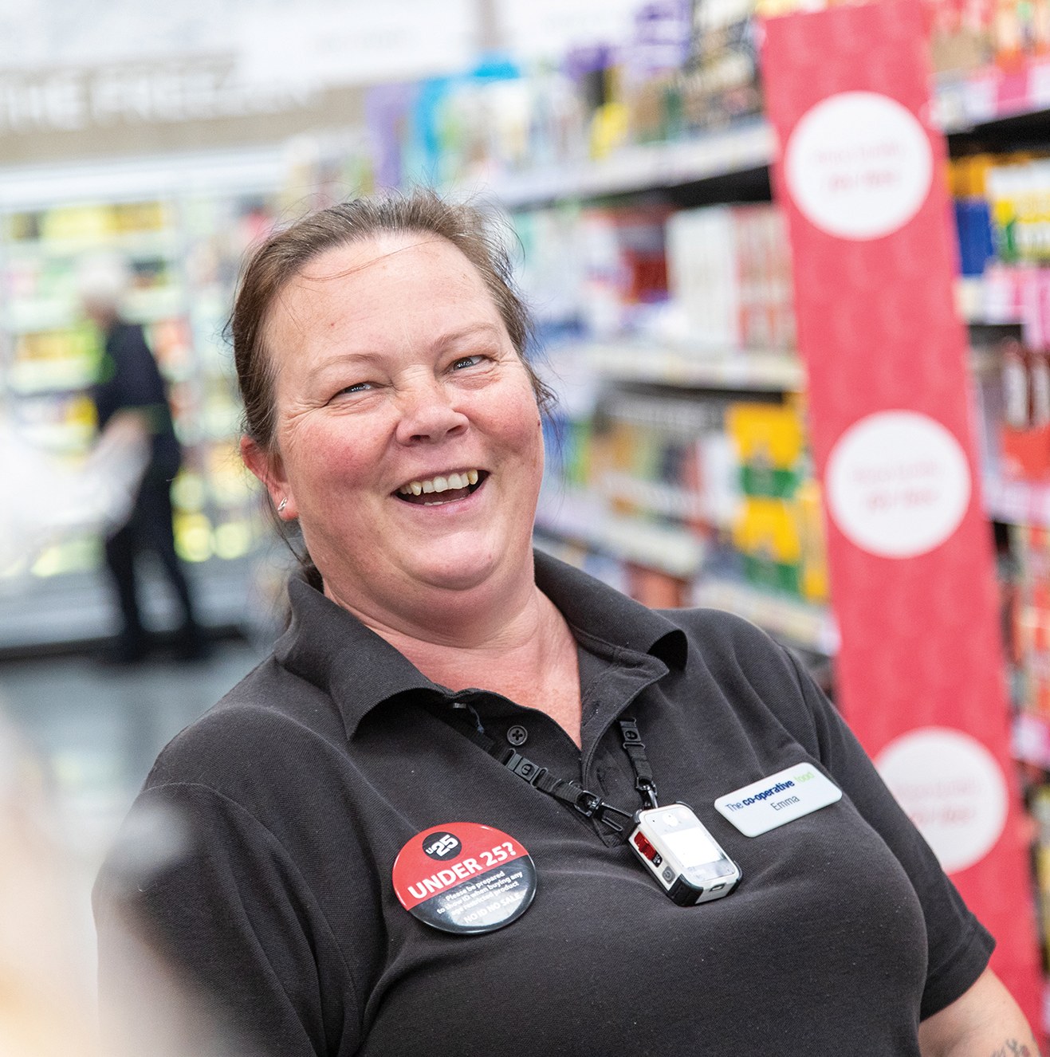
The Do’s & Don’ts of being a good Ally
Do:
Be open to listening
Be aware of your own bias
Examine your own behaviour
Educate yourself to learn more
Take responsibility for your own actions
Do:
Share opportunities for others
Use your own voice to call things out
Accept feedback with grace even if its uncomfortable
Work everyday on becoming a better ally
Don’t:
Expect to be taught or shown – take it upon yourself to learn
Compare how your struggle ‘is just as bad as’ a marginalised person(s)
Behave as though you know best
Don’t:
Assume you understand other people’s situations or feelings
Ignore prejudice behaviours or comments or make excuses for other people that are not willing to learn

Slide 6
Useful Links & Reading:
LINKS:
What is a true Ally - YouTube
https://youtu.be/gtALM4fOy0E?si=kGfuc-Ylad70bdaR
Allyship in Practice – YouTube
https://youtu.be/f3f_pHYo2rM?si=yl694gedq2LKykWT
Allyship at work - YouTube
https://youtu.be/8Y_2YpU2-vk?si=ogmhKuZ3AsYt9yzV
BOOKS:
Disability Visibility – Authors: Alice Wong (Editor), Harriet McBryde Johnson (Contributor), Talila A. Lewis (Contributor)
It’s Not About The Burqa – Author: Miriam Khan
Trans Allyship Workbook – Building Skills to support Trans People In Our Lives – Author: Davey Shlasko

Slide 7
Notes & Discussion Points
_____________________________________________________________________________________________________________________________________________________________________________________________________________________________________________________________________________________________________________________________________________________________________________________________________________________________________________________________________________________________________________________________________________________________________________________________________________________________________________________________________________________________________________________________________________________________________________________________________________________________________________________________________________________________________________________________________________________________________________________________________________________________________________

