Slide 1
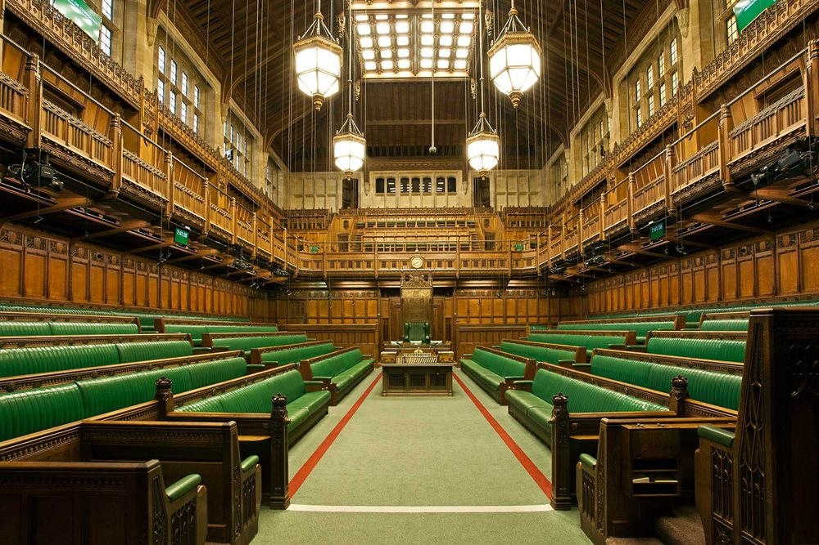
ELECTION MANIFESTO BRIEFING

Slide 2
KEY TAKEAWAYS
Both Labour and the Liberal Democrats have committed to scrapping business rates in their current form, while the Conservatives have pledged to ease the burden of business rates on the high street, leisure and hospitality by gradually increasing the tax for online shopping warehouses. Labour have committed in their first 100 days to increasing workers' rights, strengthening protections for trade unions and recommending a higher national minimum wage which accounts for the cost of living. All three parties support a clampdown on crime which includes tougher sentences for assaults against retail workers. Both Labour and the Liberal Democrats are seeking to reform the apprenticeship levy to a broader and more flexible skills and training levy. The Tobacco and Vapes Bill, which was shelved at the same time as the Criminal Justice Bill, will be revived by the Conservatives. Labour has pledged to ban junk food advertising and the sale of energy drinks to u16’s, while the Conservatives have committed to restricting advertising of products high in fat, sugar or salt, and to “gather new evidence on the impact of ultra-processed food”. The Liberal Democrats will extend free school meals to all children in poverty.

Slide 3
TAX + FINANCE
LABOUR
CONSERVATIVE
LIBERAL DEMOCRATS
Will not increase Income tax, National Insurance (NI) or VAT. Corporation Tax to be capped at 25 per cent. End VAT exemption and business rates relief for private schools to invest in state schools. Abolish non-dom tax status. End short-term economic policy making with the establishment of an Industrial Strategy Council Every fiscal event making. significant changes to taxation or spending will be subject to an independent OBR forecast.
2p cut to National Insurance (NI) by April 2027 Longer term goal of abolishing NI Scrap the main rate of self-employed NI over course of next Parliament No rise in income tax, National Insurance and VAT. Triple Lock Plus – Pensions tax guarantee Crackdown on tax avoidance and evasion to raise a £6bn a year 2-year Capital Gains Tax exemption (for some landlords)
Cut income tax by raising the tax-free personal allowance, benefitting the vast majority of families and taking more low-paid workers out of paying income tax altogether. Implement a tax policy that recognises how high the Conservatives have raised personal taxes, making the cost-of-living crisis worse, by instead focusing tax changes on reversing the Conservatives’ tax cuts for big banks and imposing a proper, one-off windfall tax on the super-profits of oil and gas producers and traders.
Key policies

Slide 4
CRIME
LABOUR
CONSERVATIVE
LIBERAL DEMOCRATS
Scrap the effective immunity for some shoplifting and create a new specific offence for assaults on shopworkers. New Neighbourhood Policing Guarantee. Create new Young Futures programme in communities to drive down knife crime. New Respect Orders to ban persistent adult offenders of anti-social behavior from town centres. Specialist rape and sexual offences team in every police force.
8,000 more police officers with a new officer for every neighbourhood Tougher sentencing on assaults against retail workers Introduce hotspot policing to crackdown on anti-social behaviour 25-year prison term for domestic murders and review of homicide sentencing Build 4 additional prisons
Prevent crime and build communities where people can truly feel safe including by restoring proper community policing, where officers are visible, trusted and focused on preventing and solving crimes. Create a new statutory guarantee that all burglaries will be attended by the police and properly investigated.
Key policies

Slide 5
SKILLS & APPRENTICESHIPS
LABOUR
CONSERVATIVES
LIBERAL DEMOCRATS
Replace the apprenticeship levy with a broader and more flexible ‘Growth and Skills Levy’. Establish Skills England to ensure there is the highly trained workforce needed to deliver Labour’s Industrial Strategy.
100,000 additional apprenticeships per year, funded through scrapping of ‘mickey mouse’ university courses Introduction of Advanced British Standard, a new vocational training qualification £30,000 tax-free bonuses for new teachers in technical and STEM subjects Deliver on Lifelong Learning Entitlement with new qualifications and expansion of adult skills programmes
Replacing the apprenticeship levy with a broader and more flexible skills and training levy. Boosting the take-up of apprenticeships, including by guaranteeing they are paid at least the National Minimum Wage by scrapping the lower apprentice rate. Creating Lifelong Skills Grants for adults to spend on education and training throughout their lives. Developing National Colleges as national centres of expertise for key sectors, such as renewable energy, to deliver the high-level vocational skills that businesses need.
Key policies

Slide 6
FOOD & FARMING
LABOUR
CONSERVATIVE
LIBERAL DEMOCRATS
Half of all food purchased across the public sector to be locally produced or certified to higher environmental standards. Introduce a land-use framework and make environment land management schemes work for farmers and nature. Work with farmers and scientists on measures to eradicate Bovine TB and end the ineffective badger cull.
Increase farming budget by £1 billion Reform planning system to deliver fast track permissions for the building of infrastructure on farms, such as glasshouses, slurry and grain stores, and small-scale reservoirs. Support the agricultural sector by moving away from the reliance on seasonal migrant labour. Improve public sector procurement with the goal of at least 50% of food expenditure spent on food produced locally or to higher environmental production standards
Introduce a holistic and comprehensive National Food Strategy Maintain high health, environmental and animal welfare standards in food production and guarantee that all future trade deals will meet them too Give consumers confidence in the food they eat by providing authorities with greater powers and resources to inspect and monitor food production. Ensure all imported food meets UK standards for health and welfare, and that goods are properly checked. Introduce robust and clear-to-understand food labelling.
Key policies

Slide 7
NET ZERO & ENVIRONMENT
LABOUR
CONSERVATIVE
LIBERAL DEMOCRATS
Decarbonise the power system by 2030 Creation of state-owned GB Energy, capitalised with £8.3bn, to invest in domestic power sources. Greater cooperation with the private sector to double onshore wind, triple solar power, and quadruple offshore wind by 2030. New Energy Independence Act to set out Labour’s framework for climate and energy policies.
Invest £1.1 billion into the Green Industries Growth Accelerator Support solar by changing planning rules to protect agricultural land Continue to develop a UK-wide Deposit Return Scheme, while working to minimise the impact on businesses and consumers.
Cut resource use, waste and pollution by accelerating the transition to a more circular economy Introduce a deposit return scheme for food and drink bottles and containers, working with the devolved administrations to ensure consistency across the UK, learning the lessons from the difficulties with the Scottish scheme. Aim for the complete elimination of non-recyclable single-use plastics within three years and replacing them with affordable alternatives.
Key policies

Slide 8
HEALTH & WELFARE
LABOUR
CONSERVATIVE
LIBERAL DEMOCRATS
A ban on junk food adverts on TV before 9pm A ban on caffeinated energy drinks from sale in shops and online to under-16s Ban fast food outlets near schools. Revive proposals in Henry Dimbleby’s National Food Strategy, raising the prospect of a wave of taxes on HFSS foods and a ban on advertising of UPF products.
Bring forward Tobacco and Vapes Bill in first King’s Speech. Continue to tackle childhood and adult obesity and will legislate to restrict the advertising of products high in fat, salt and sugar. Gather new evidence on the impact of ultra processed food to support people to make healthier choices.
Extend free school meals to all children in poverty, with an ambition to extend them to all primary school children when the public finances allow.
Key policies

Slide 9
EMPLOYMENT
LABOUR
CONSERVATIVE
LIBERAL DEMOCRATS
Now only commit to introduce – rather than pass – employment legislation within the first 100 days of entering government. Remove the discriminatory age bands and the minimum wage will for the first time reflect the need for pay to consider the cost of living. Work with the Low Pay Commission, trade unions, employers to address the ongoing issue of low pay. Committed to strengthening the rights of employees by empowering workers to organise collectively through trade unions.
Maintain the National Living Wage in each year of the next Parliament at two-thirds of median earnings. On current forecasts, that would mean it rising to around £13 per hour. Overhaul the fit note process so that people are not being signed off sick as a default.
Give everyone a new right to flexible working and every disabled person the right to work from home if they want to, unless there are significant business reasons why it is not possible. Uphold the Equality Act 2010 Require large employers to monitor and publish data on gender, ethnicity, disability, and LGBT+ employment levels, pay gaps and progression, and publish five-year aspirational diversity targets
Key policies

Slide 10
GOVERNMENT CONTRACTS
LABOUR
CONSERVATIVE
LIBERAL DEMOCRATS
Implement a new Office for Value for Money to ensure all taxpayers’ money is spent wisely and the implementation of a new National Procurement Plan to ensure social value is mandatory in contract design.
Improve public sector procurement with the goal of at least 50% of food expenditure spent on food produced locally or to higher environmental production standards. Work with public sector organisations including local authorities and NHS trusts and companies benefitting from government contracts to ensure that procurement opportunities are focused on SMEs in their local economies where possible and practical.
Tackle the late payments crisis by requiring all government agencies and contractors and companies with more than 250 employees to sign up to the prompt payment code, making it enforceable.
Key policies

